Slide 1
Task 2
Paper Review:
A hybrid modeling approach for parking and traffic prediction in urban simulations
Presented By:
Tahmid Zarif Ul Hoq Sayor - 23266015
CSE718
Fall-2023
Section 01
Group-11
ST- Mehnaz Ara Fazal
RA- Humaion Kabir Mehedi

Slide 2
Paper Overview
Original Article
Authors: Rahmatollah Beheshti & Gita Sukthankar
Published: 14th Feb 2014 : Springer
Doi: https://doi.org/10.1007/s00146-013-0530-7

Slide 3
Paper summary:
AIM
Providing precise tools for Urban-planning
Aid policy-makers in terms of decision making

Slide 4
Paper summary:
Contribution
Agent Based Model
(ABM)
Markov Chain Monte Carlo (MCMC)
Development of a Hybrid (ABM-MCMC) model to enhance prediction accuracy
Hybrid Model
(ABM-MCMC)

Slide 5
Paper summary:
Methodology
Case Studied in main campus of University of Florida
Agent based model (ABM) part prepared based on survey data
which includes
Daily attendance patterns
Initial location
Visitation frequency for on-campus dining locations
Usage patterns for recreation and athletic facilities
Usage of administrative and other miscellaneous locations
Frequency of parking lot and shuttle stop usage

Slide 6
Paper summary:
Methodology
Markov Chain Monte Carlo (MCMC) portion based on Metropolis-Hastings algorithm
In Hybrid model MCMC works based on the ‘proposal distribution’
provided by ABM
Predictions
Proposal
Distribution
Agent Based Model
(ABM)
Markov Chain Monte Carlo (MCMC)
Hybrid model
(ABM-MCMC)

Slide 7
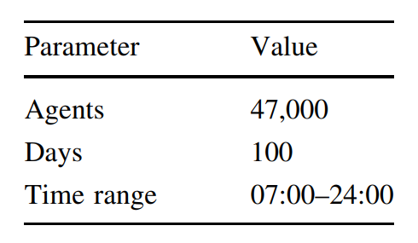
Paper summary:
Methodology
Simulation:
Time updates every hour
Students are the agents
An agent cannot perform multitasking
Every agent behaviour is constant throughout its lifecycle
[1]

Slide 8
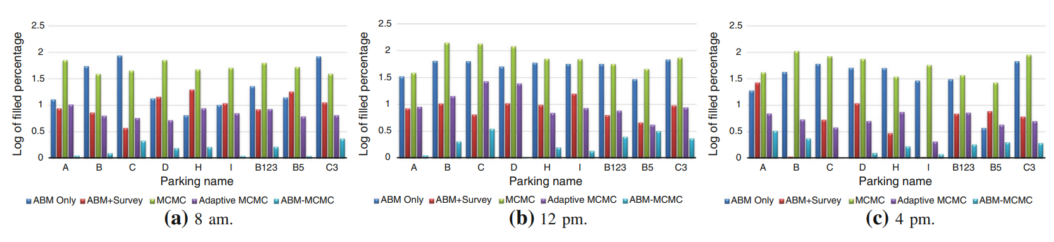
Paper summary: Conclusion
Fig1: The absolute difference (plotted on a log-scale) between the average occupancy percentage of the campus parking lots as predicted by different modeling methods compared to the UCF Parking Services data.
[1]

Slide 9
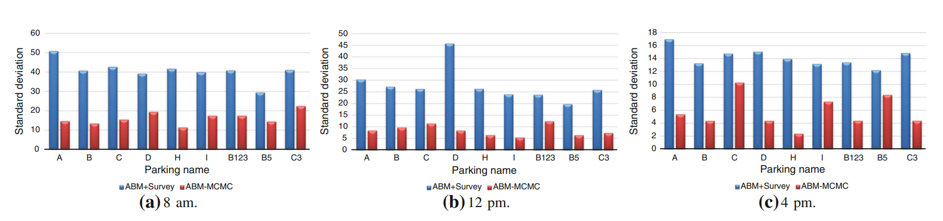
Paper summary: Conclusion
Fig2: The standard deviation of predicted values for parking usage
[1]

Slide 10
Paper Limitation:
First Critique
Not validated across different scenarios
May fail to generalize

Slide 11
Paper Limitation:
Second Critique
ABM generated proposal distributions are more complex
compared to those typically used to initialize MCMCs
Harder to carry out future researches

Slide 12
Synthesis
Urban Modelling is a challenging task
Despite challenges, the Hybrid model may offer improved stability and accurate predictions
Future research is needed to validate the generalization of the proposed model

Slide 13
Thank You

Slide 14
References
Beheshti, R., Sukthankar, G. A hybrid modeling approach for parking and traffic prediction in urban simulations. AI & Soc 30, 333–344 (2015). https://doi.org/10.1007/s00146-013-0530-7

